Slide 1
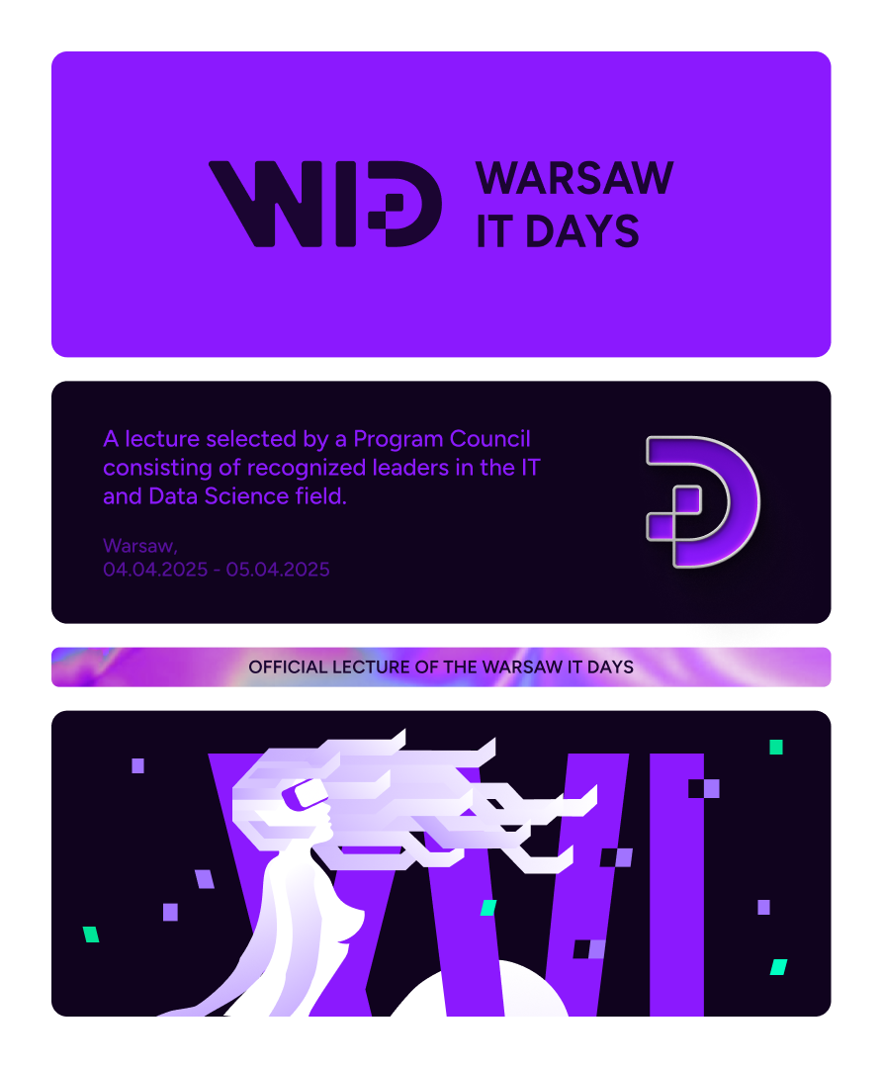
A quest for optimal HTTP client DX
Igor Savin
Principal Software Engineer at Lokalise
Event organized by: Academic Partners Foundation

Slide 2

whoami
Member of fastify organization
Lead maintainer of knex.js
Presented “Advanced caching in Node.js”
Author of:
message-queue-toolkit
node-service-template
layered-loader
opinionated-machine
toad-scheduler
@lokalise/api-contracts
@lokalise/backend-http-client
Igor Savin aka kibertoad
Principal Software Engineer
Lokalise

Slide 3
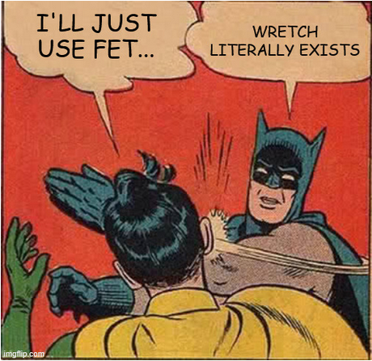
Reinventing bicycles 101
“I’ll just use fetch” - number 1 source of solving already solved problems in every frontend application since 2015.
Boilerplate-heavy JSON handling;
Boilerplate-heavy error handling;
No middleware support.

Slide 4
Leveling up your HTTP client game Level “Basic”

Slide 5
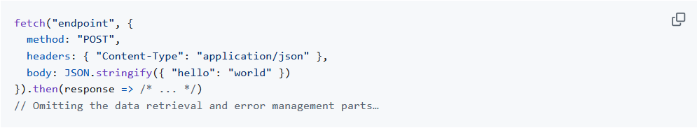
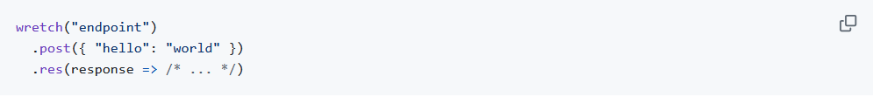
Eliminating boilerplate: JSON requests
fetch
wretch

Slide 6
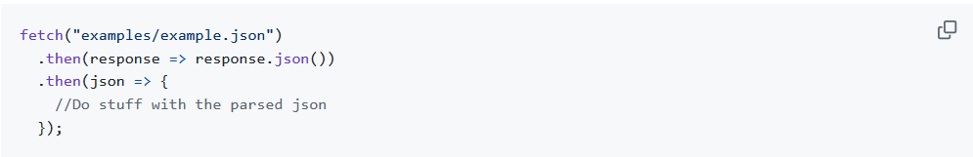
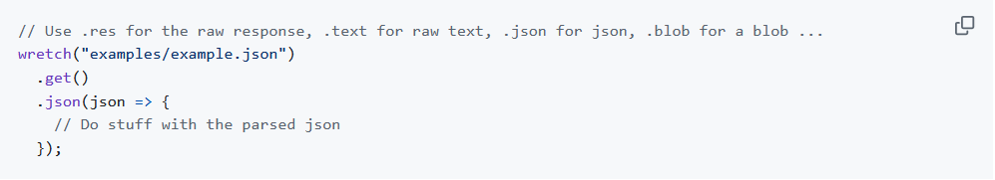
Eliminating boilerplate: JSON responses
fetch
wretch

Slide 7
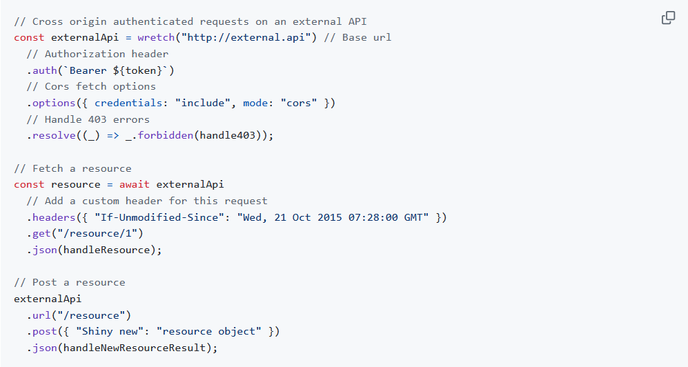
Eliminating boilerplate: reuse
wretch

Slide 8
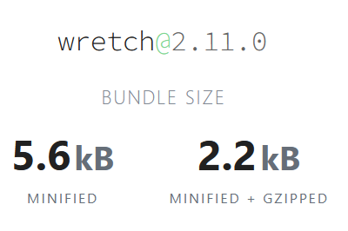
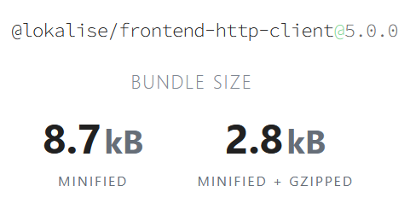
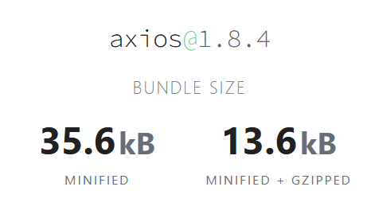
But my bundle size!..

Slide 9
Leveling up your HTTP client game Level “Advanced”

Slide 10

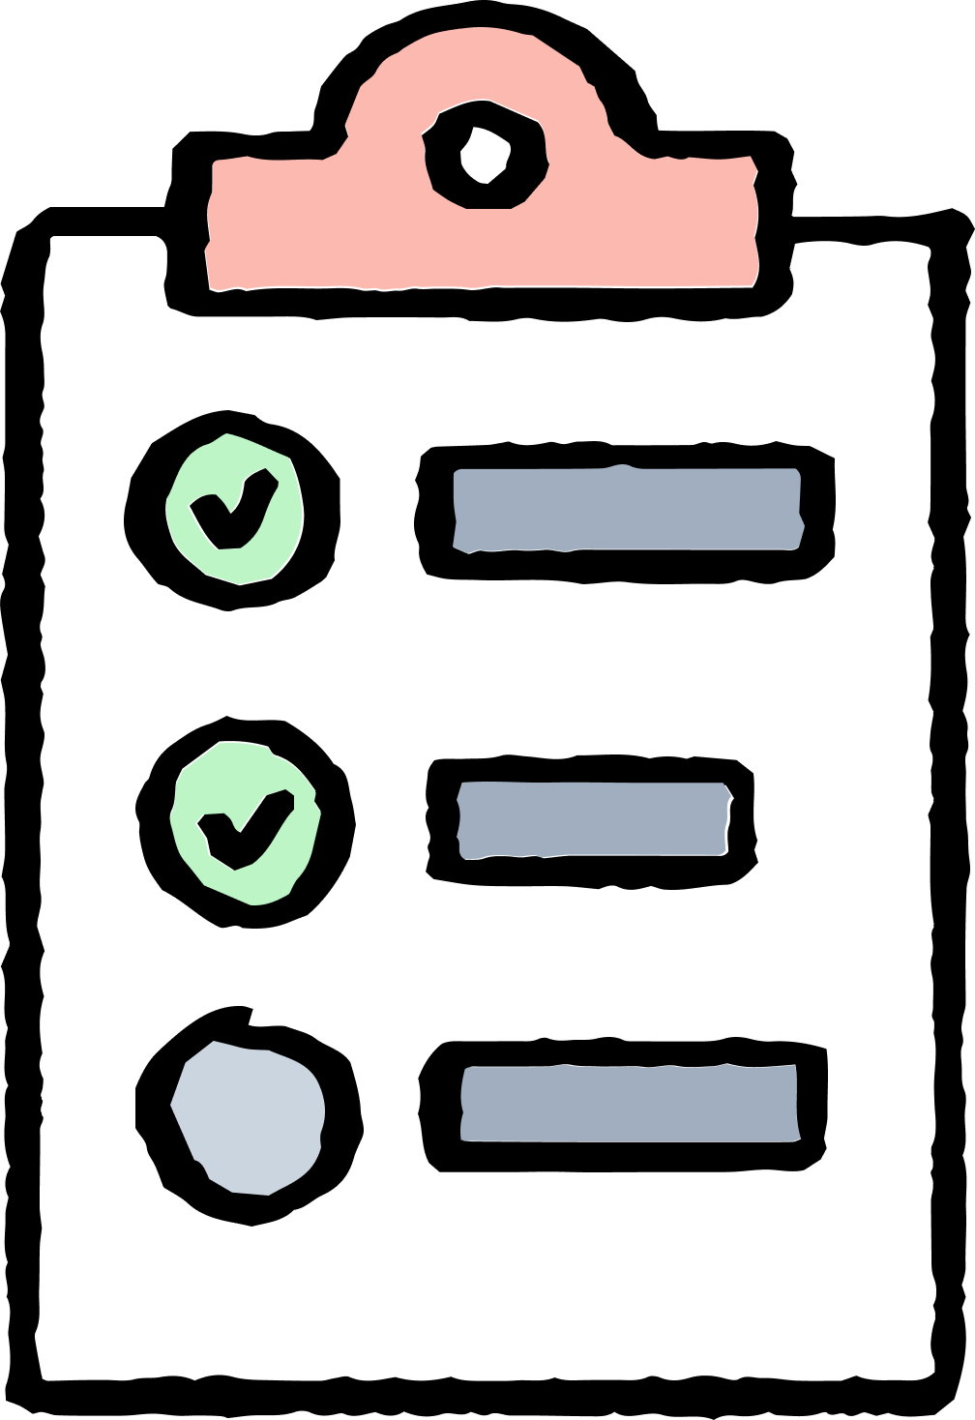
Validation, schemas and type-safety
Validation schemas:
Runtime validation
Compilation time TypeScript types
Type-safety:
Type-checks at compilation time catch problems before they happen
Runtime validation catches deviations from expected state during boundary transitions

Slide 11
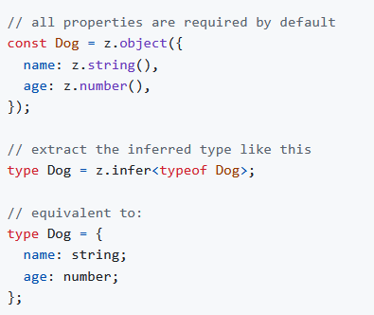
Validation schemas
zod

Slide 12
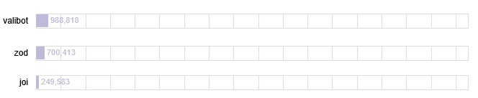
Benchmarks for popular schema-based parsing libraries
https://github.com/moltar/typescript-runtime-type-benchmarks

Slide 13
Leveling up your HTTP client game Level “Expert”

Slide 14
End-to-end contracts
Define complete contracts for your endpoints:
HTTP request method
Request, response, query, path params
Use for:
Controller definition on the backend
Request validation and type inference on backend & frontend
Type-safe mocking

Slide 15
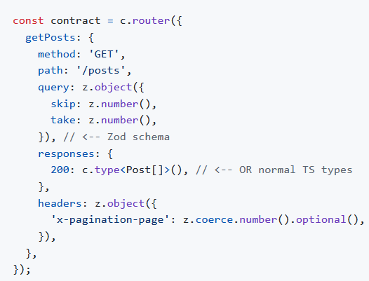
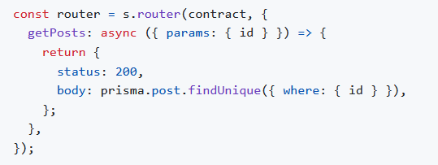
TS-REST
Contract definition
Controller definition

Slide 16
Leveling up your HTTP client game Level “Galaxy Brain”

Slide 17
Best-practices-as-a-code
Enforce best practices via wrapper:
Mandatory schemas?
Mandatory contracts?
Mandatory extended metadata for debugging purposes?
Specific logging and error handling?

Slide 18
@lokalise/api-contracts
Demo time!
https://github.com/kibertoad/a-quest-for-http-client-dx

Slide 19

Thank you for watching!
Remember to leave your questions
and rate the presentation
in the section below.
Event organized by: Academic Partners Foundation

Slide 20
